Slide 1
Linux Access Controls
Cybersecurity
Lesson 4.2

Slide 2

By the end of today’s class, you will be able to:
1
Audit passwords using john.
2
Elevate privileges with sudo and su.
3
Create and manage users and groups.
4
Inspect and set file permissions for sensitive files on the system.

Slide 4

Recap
Linux and Command Line
01
Linux history and distributions
02
Navigating file structure with command line
03
Managing processes with top, ps, and kill
04
Installing packages with apt

Slide 5
Access controls refer to regulating what actions
users and programs are
and are not allowed to take
on the system.

Slide 6

Users and Passwords

Slide 7
We previously examined the /etc/shadow file, containing the hashes of every user’s password. These are obfuscated with a hashing function.

Slide 8
A hash is a cryptographic function that takes data as input and translates it to a string of different data that seems random.

Slide 9




Password Hashes
Plain Text Password
Hashing Function
Hashed Password
6ee03da581f8108d401562e80cc1710d
P@$$w03d!!
Remember: A hash will always output the same string for the same input data.

Slide 10

Password Cracking
Password Cracked
Brute Force Attacks
Cracking tools do not reverse a password hash
  Generate hashes of words/characters
    Custom wordlists
    Prebuilt popular wordlists
Computed hashes compared to original hash
  If two match, password has been found
This is a form of brute force attack

Slide 11
What makes a stronger password? Its complexity or length?

Slide 12
What is the current industry-standard length for a password?

Slide 13
8 Characters

Slide 14
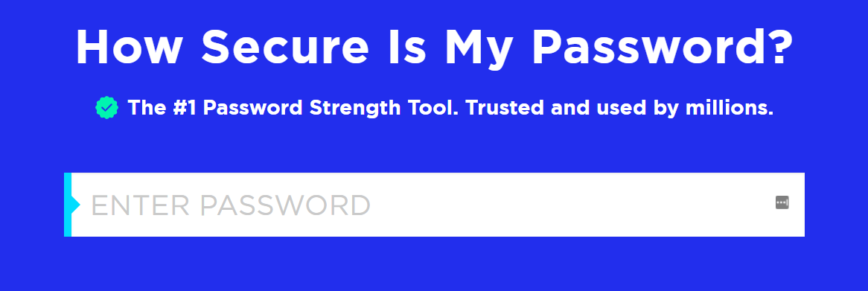
How Secure Is My Password?
Go to How Secure Is My Password? | Password Strength Checker

Slide 15
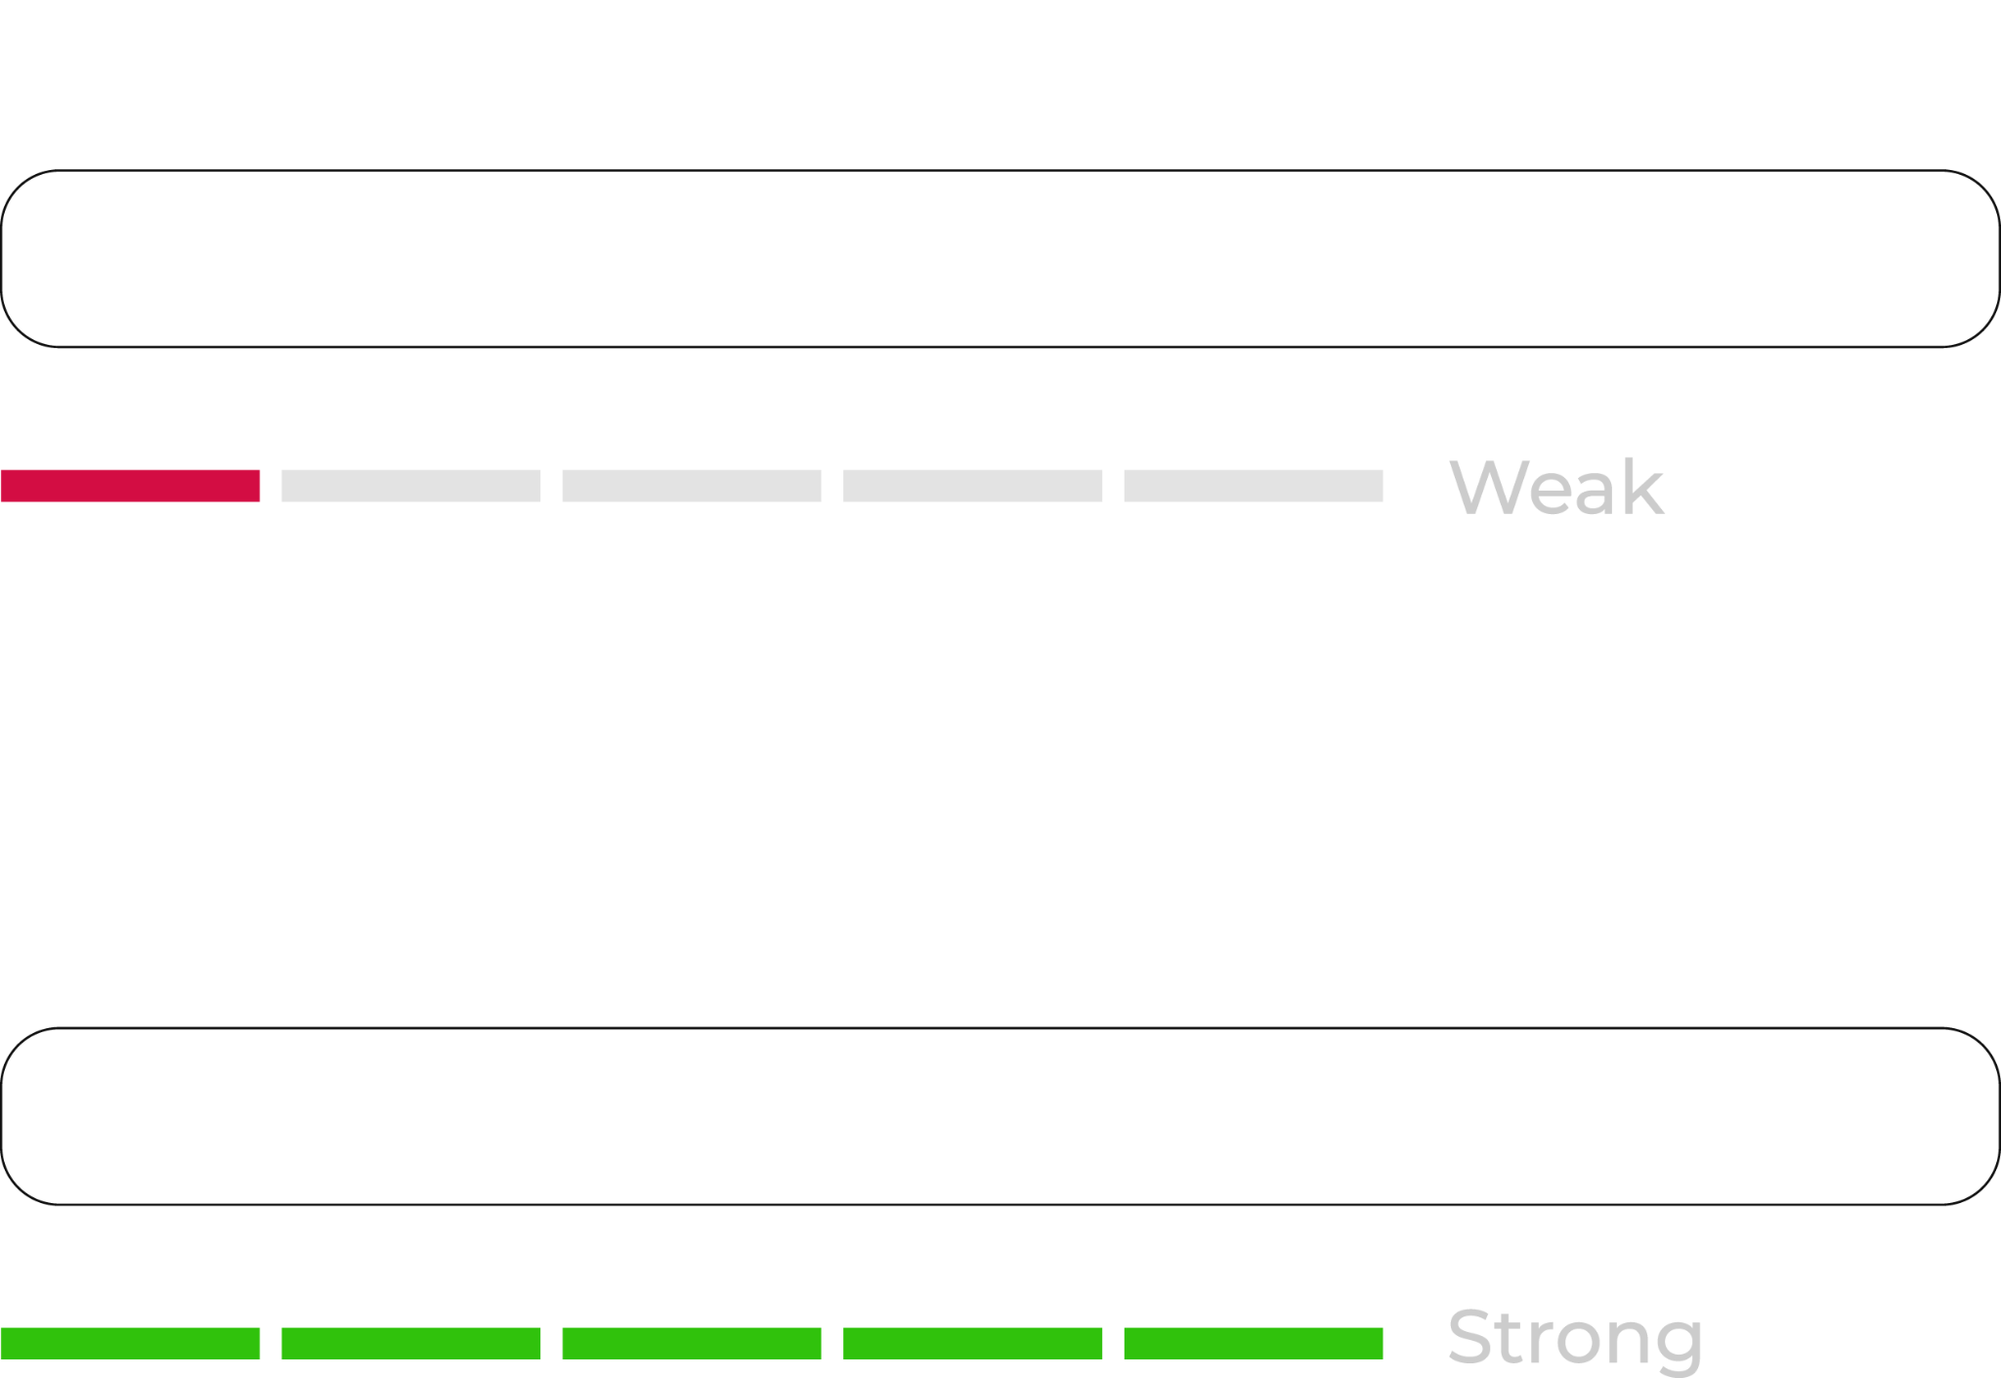
Secure Password Takeaways
If a system requires passwords of only 16 characters, the password will be relatively strong, even if it contains words.
Add a few extra characters and it will become exponentially more secure.
In contrast, if a password uses all random characters, it still must be at least 10-characters long to be very effective.
****
************
Notes:
shutterstock_1775204195

Slide 16




Cracking Passwords
Modern password cracking software works using the following steps:
Matches indicate password used
Compare each hash to the list used as input
Take a list of hashes as input
Hash passwords from a given list

Slide 17
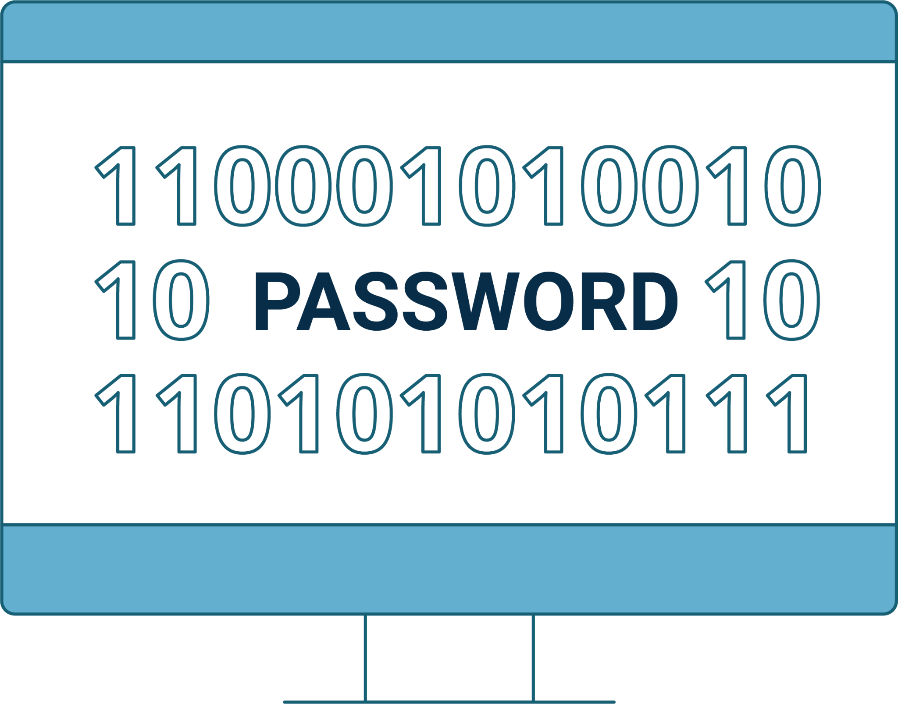
John the Ripper
Two-step process:
Create a hashlist
Run John the Ripper

Slide 18

Creating the Hashlist
John the Ripper
John can take an input file containing:
Usernames
Password hashes
John requires files to adhere to specific format:
admin:e08e4506d2e3f370a5e8ab79647df309
Username
Password Hash

Slide 19

Running John the Ripper
Syntax Options
Basic Usage
Pre-defined wordlist
john <hashlist>
Cracked hashes
john <hashlist>
john <hashlist> --wordlist=/path/to/wordlist
john --show <hashlist>

Slide 20

Talk to John
In this activity, you will continue your role as a junior administrator auditing the system. Now, the focus will be on passwords.
You will use john, which we installed in the previous class, to crack the password hashes for several of the users on our system.
20 Minutes

Slide 23

Privileges, root, sudo, and su

Slide 24
We’ve used sudo for several commands in this unit.
Why do you think some commands require sudo and others don’t?

Slide 25
Privileges and Users
Why do we need to use sudo for some commands, and not others?
Users
Groups
Root
Every file and program on a Linux system has permissions.
These permissions tell the system which users can access a file or run a program.
Users can be placed in groups, which can have their own permissions.
File and program permissions apply to all users except the root.
The root user (or super user) has complete access to the system and can perform any task.

Slide 26
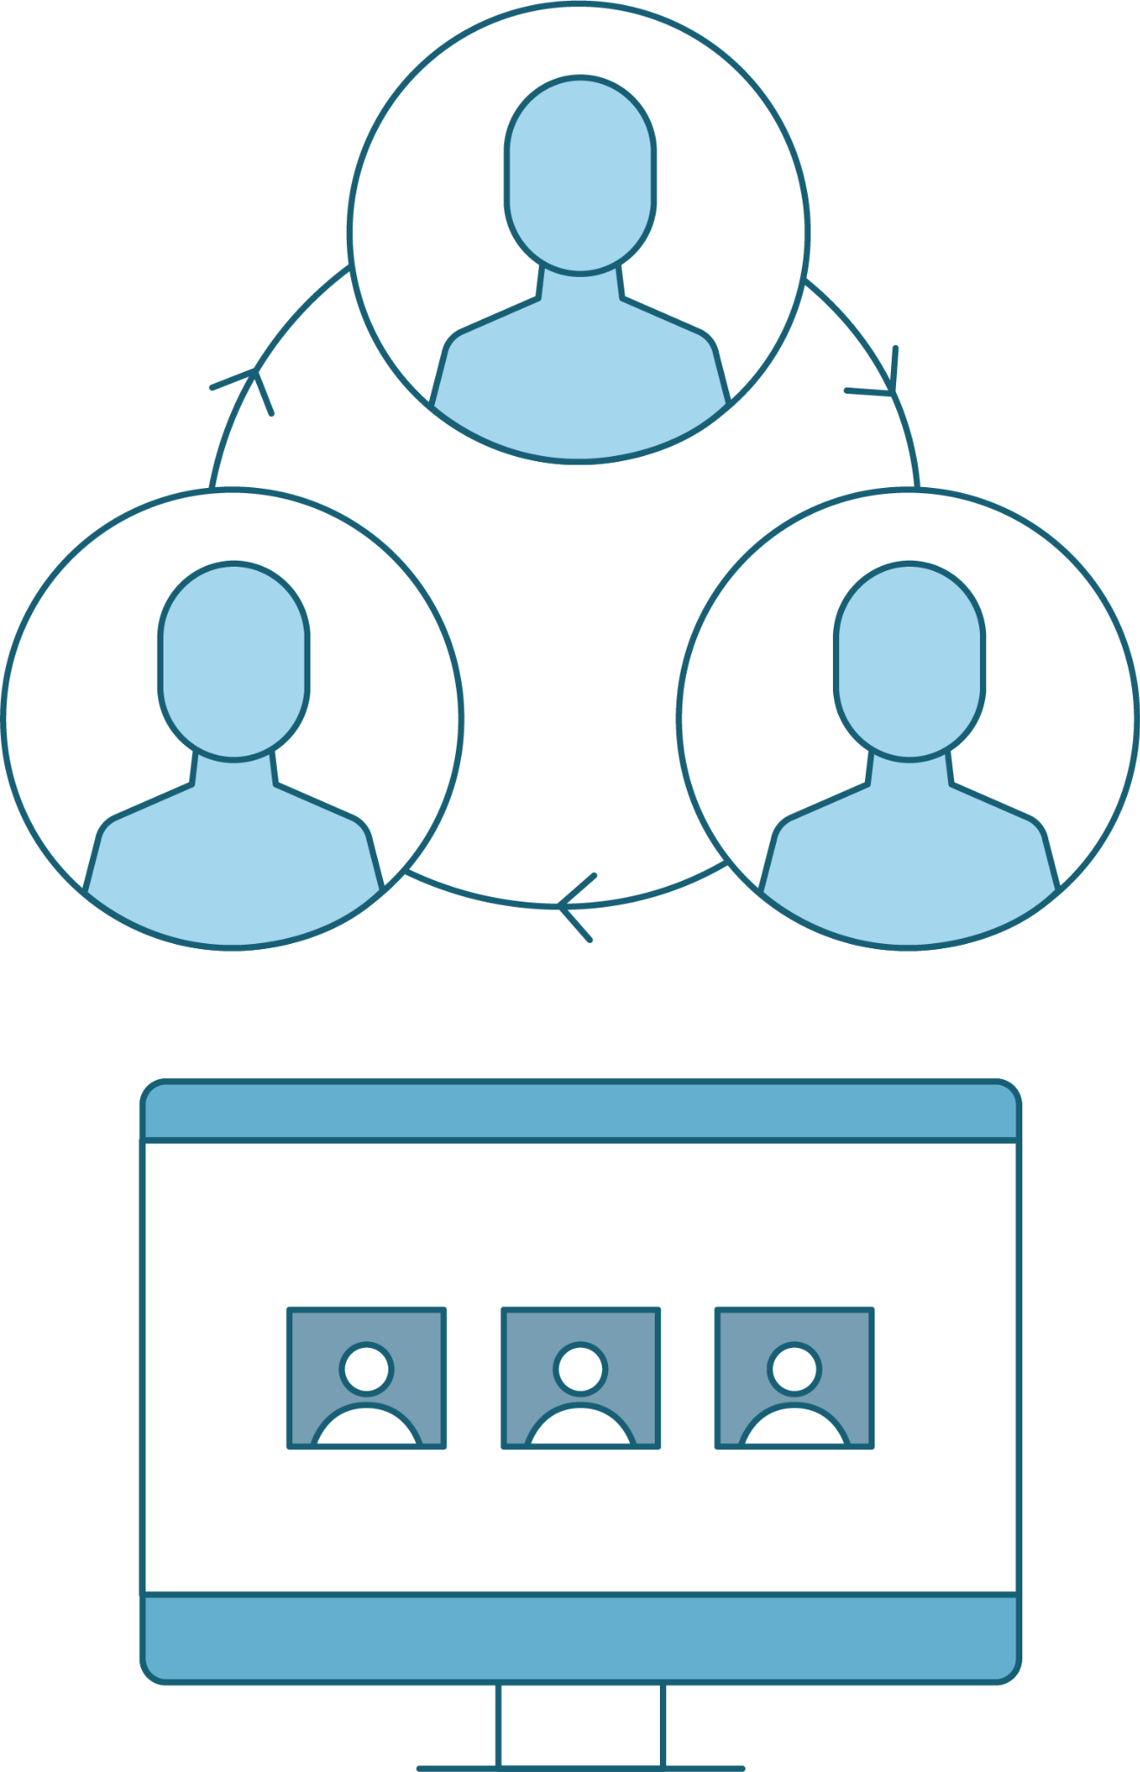
Switching Users
Elevating Privileges
In Linux, you can access different users with su
“Switch User”
su <username>
Helpful for troubleshooting
Imitate the user

Slide 27
Root Access
Properly secured Linux systems do not allow anyone to login as root
sudo stands for “superuser do”
After the sudo command is run, users are reverted to their usual access
sudo can also control which commands the user can run as root.

Slide 28

Demonstration Scenario
We will attempt to update all of our existing software packages.
If our privileges do not allow us to do so, we will first use su to switch directly to the root user.
We'll then demonstrate the dangers of working directly as the root user.
We'll then do the same updates by using sudo instead and demonstrate why this is the more secure option.
.
Notes:
shutterstock_1888488028

Slide 29
su vs sudo

Slide 30
Demo Summary
Let’s Recap
whoami
sudo
su
sudo -l
visudo

Slide 31
sudo Wrestling
So far, we have been using administrator privileges to stop processes, install software, copy sensitive files, run programs, and edit configuration files.
The senior administrator has asked that you audit the system for sudo and root access, making sure that no users other than the admin user have access to any sudo use.
Lock access to the compromised system, including sudo access.
25 Minutes

Slide 35

Users and Groups

Slide 36

Users and Groups
Users on a Linux system can be added to groups. Linux has the ability to create groups of users for functions like file and service sharing.
If a company has different departments, like sales, accounting, and marketing, a Linux admin can create a group for
each department.
Only users in each group can
access files owned by the group.
Linux Admin
Sales
Accounting
Marketing
Notes:
shutterstock_1849976488

Slide 37
System administrators need to know how to manage users and groups.

Slide 38
id Command
Linux identifies users and groups in the system using the id command:
Linux associates a specific number with each user, known as the user ID (UID).
Linux uses the UID, not the username.
System users have a UID that is less than 1,000.
Standard users have a UID that is greater than 1,000.
The root user always has the UID of 0.

Slide 39



Demonstration Scenario
In the upcoming demo, we’ll dive into more actions for user and group management using the following scenario:
Your company recently made changes to the developer team.
Mike, a lead developer, has left the company.
Joseph has joined as a new junior developer.
Notes:
shutterstock_1888488028

Slide 40




Demonstration Scenario
The company’s Linux system has never been set up properly with a developers group.
Instead, Mike was part of the general group.
General group
Notes:
shutterstock_1888488028

Slide 41
Demonstration Scenario
As the sysadmin for this system, you need to remove Mike from the general group, remove the general group, and delete Mike from the system.
General group
Mike, a lead developer, has left the company.
Notes:
shutterstock_1888488028

Slide 42


Demonstration Scenario
Then, you need to add Joseph to the system, create a developers group, and add Joseph to this group.
Developers group
Joseph has joined as a new junior developer.
Notes:
shutterstock_1888488028

Slide 43
Users and Groups Scenario
To accomplish these tasks, we will use the following commands:
groups | Get group info for the user mike.
usermod | Lock Mike’s account to prevent him from logging in.
usermod | Remove the user mike from the general group.
deluser --remove-home | Delete the user mike.
delgroup | Delete the general group.
adduser | Create the user joseph.
addgroup | Create a developer group.
Usermod | Add the user joseph to the developer group.

Slide 44
Users and Groups

Slide 45
Users and Groups
The administrator has asked that you audit all the users and groups on the system.
You will create a new group for the standard users and remove users from the sudo group.
In the previous activities, you found some malicious users. Now you will remove them from the system entirely.
Being able to manage users and groups is an essential skill of a system administrator. Here, we will follow the principle of least privilege to make sure that the users on the system only have the access we want them to have and are only members of the correct groups.
20 Minutes

Slide 48
Recap
Linux Access Controls
01
Cracked password hashes with john
02
Escalated privileges with su and sudo
03
Managed users and groups

Slide 49
Inspect and set file permissions, monitor services, and assign users for services

